Slide 1
L6 Group-1 Pitch 2
Caitlin White, Connor Wilby, Jamie Chandler and Jordan Marks

Slide 2
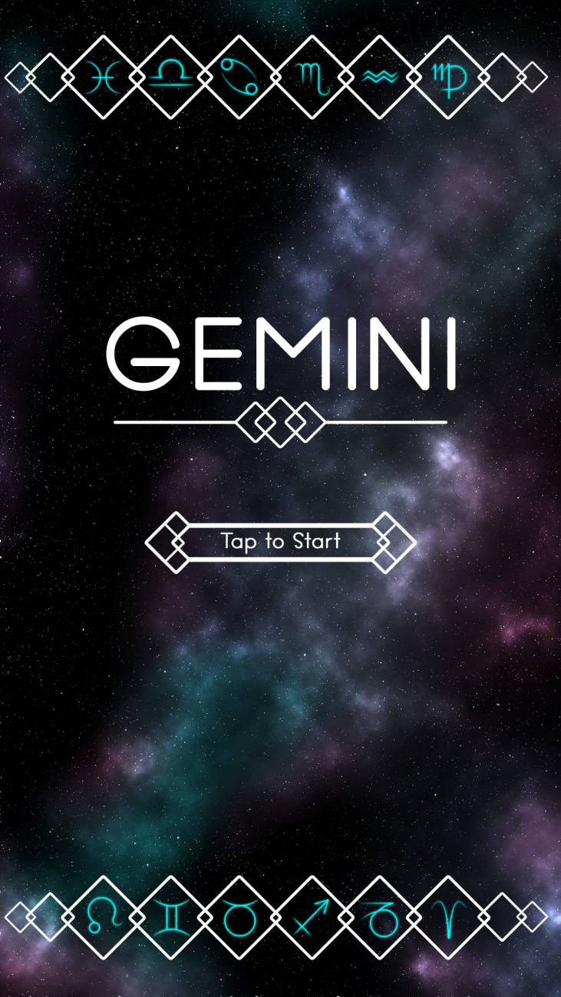
Our Brief
Mobile Platform
Potential for monetisation
Inclusion of smart depth
CW

Slide 3
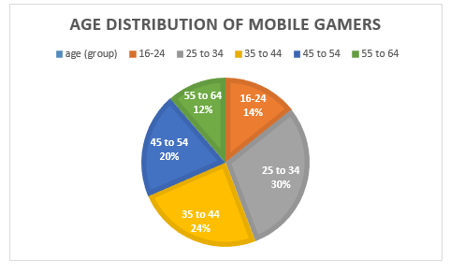
Demographic
Age: 25-44
Gender: Female
Source: http://www.realitymine.com/myth-busting-mobile-gaming-demographics/
JM

Slide 4
Psychographic
Emily
Favourite colour: Purple
Enjoys her own casual style
Enjoys shopping and reading in her spare time
Enjoys matching games
Times she spends each day on games: 2 hrs
Enjoys using social networks in the evening when she gets home to connect with her family and friends
JM

Slide 5
Extrinsic and intrinsic motivation
Extrinsic
Achievements
Social map- can see friends progress.
Leaderboards
Intrinsic
Overcoming challenges
Peer recognition and belonging – social aspect of play
CW

Slide 6


Platform and Genre
Platform: Mobile and Tablet
Genre: Hex based Puzzle
Duration: Up to 5 minutes
CJ

Slide 7
The Game Loop
Level start
Swap tiles
Complete level
Earn rewards
JC

Slide 8
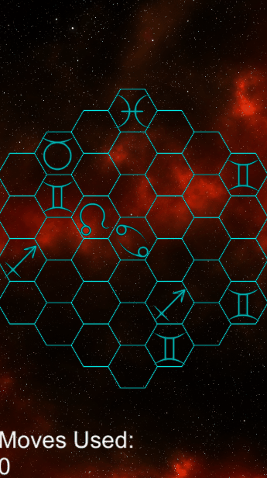
Prototype

Slide 9

Game goal and Features
Creating an unbroken chain of hexes
Using different hex types to reduce the number of moves this takes
Optimisation game
Social Map
Hard Fun:
Accomplishment
Strategy
Clear Goal
CJ

Slide 10


Hex Tile Type Concepts
Disables the tiles around it for one move
Rotates the tiles (all 6 of them) around it clockwise and anti-clockwise
JM

Slide 11
Currency
Stardust
Used to refill the players lives
Used to buy power-ups to help the player in game
Pricing Examples:
£0.99- Gets the player atleast 4 power-ups and the price for refilling lives.
£4.99- Starting bundle.
JM

Slide 12

Power-ups
Swap with any tile
Transform any tile to another tile.
5+ More moves
JM

Slide 13
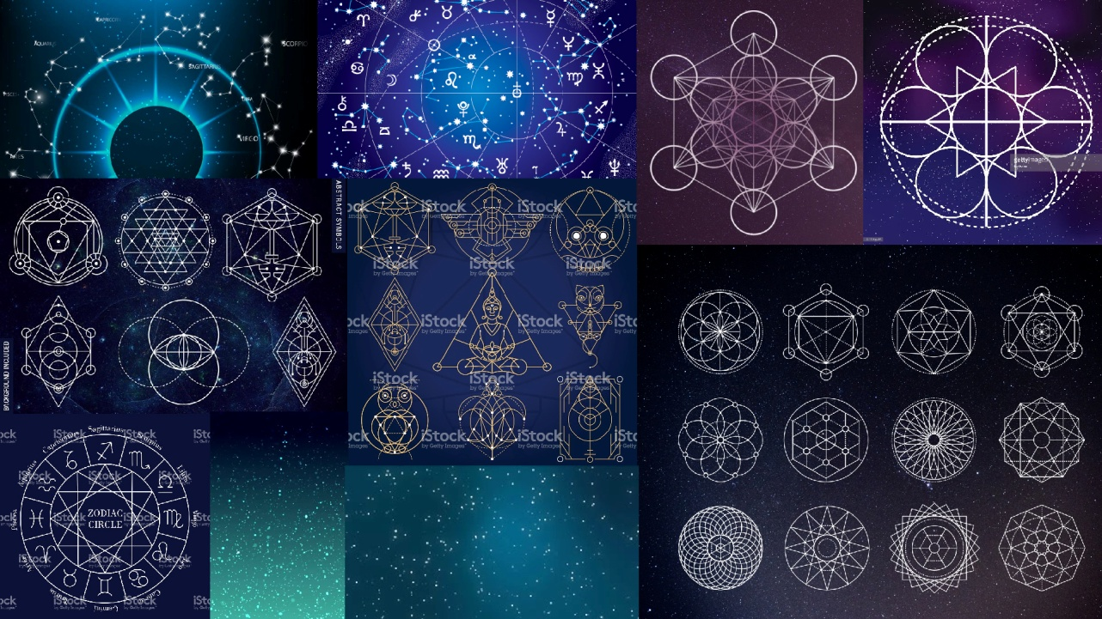
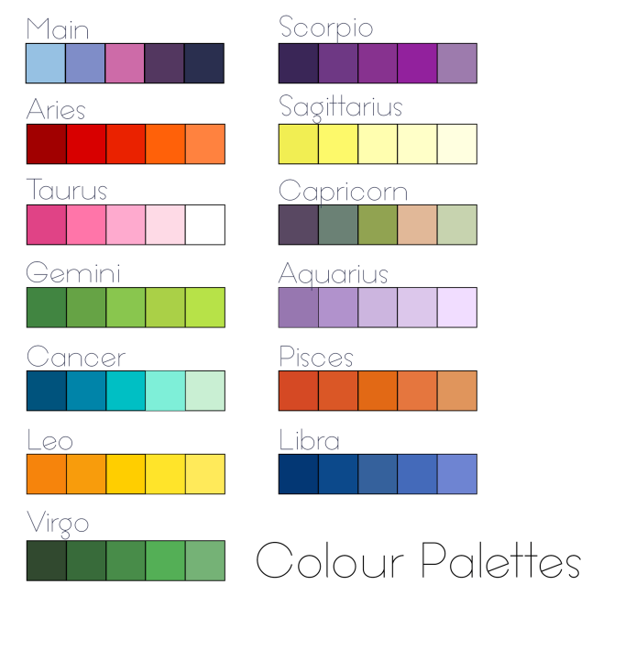

Artwork
CW/JC

Slide 14
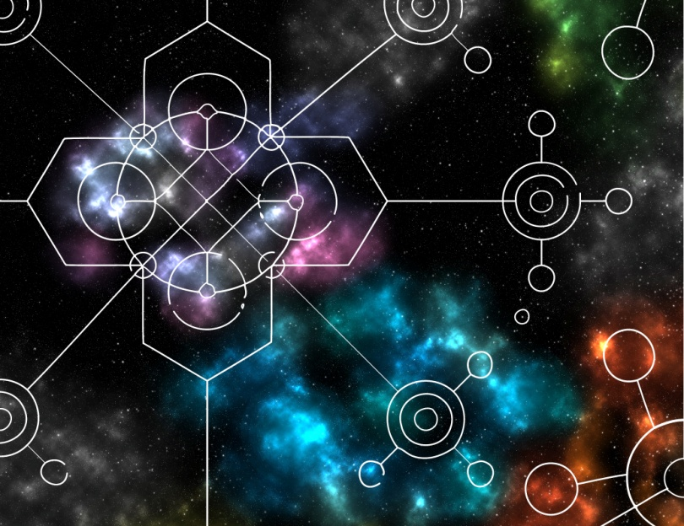
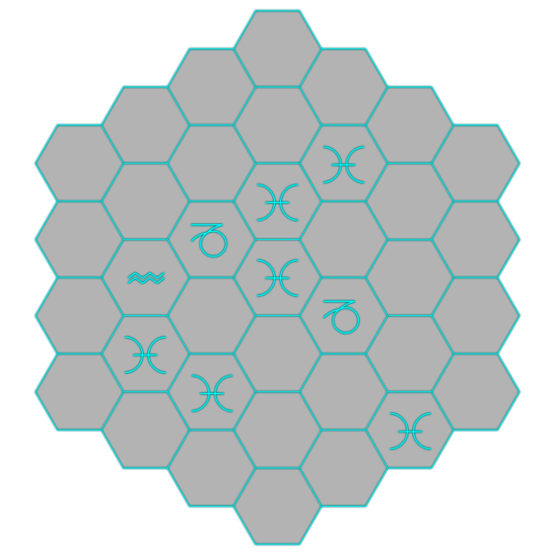
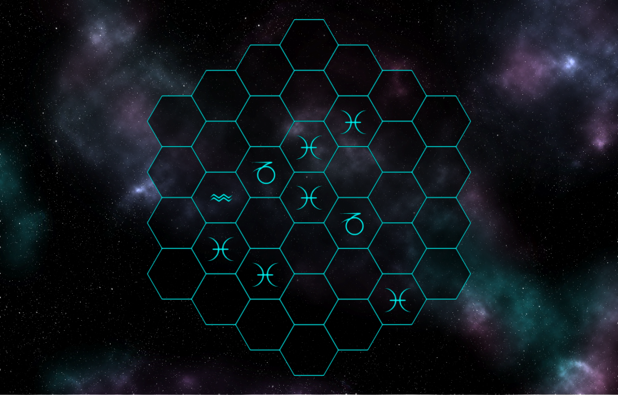
Artwork
CW/JC

Slide 15






Artwork
JC

Slide 16
What next?
Vigorous user testing
Pinpoint the strengths and weaknesses
Design and create a level editor
Design and create a level selector
Design and implement 12 tile abilities

Slide 17
Questions?

